Slide 1






June 4th 2021
WildFly Formation
Presented By : OUMINA EL Hassane
After each diapo, questions will be answered

Slide 2

Former
OUMINA EL Hassane
JAVA/JEE Developer
Consultant
Atos/Bnp
paribas
JAVA/JEE Developer

Slide 3


DRSA Demo
Features
API & translation updates
Roadmap & Next Priorities

Slide 4
BENEFIT / SERVICE RECOMMENDATION

Slide 5
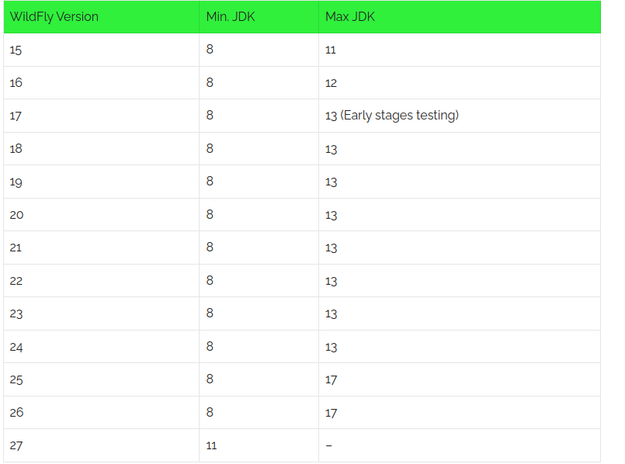
Coverage conditions display when forced eligibility
Impact: Low / Digital: No
Reference
WildFly (15-21) is Java 8
Context
On claim timeline, when a partially recommended service is selected for a given mission, then, “force service” is displayed behind service title
In the “Force” tab, unsatisfied/ missing service recommendation are displayed in order to inform the operator what made this service partially recommended.
Benefit/ service recommendation
KMA

Slide 6
PRODUCT MIGRATION

Slide 7


Product covered areas
Impact: High / Digital: No
Reference
COREDRSA-6305
Context
Only one covered area is allowed for benefit on the backoffice.
Before
After
Product migration
CAT

Slide 8
NOT YET DELIVERED IN PRODUCTION
RENTAL CAR
ADVANCED MISSIONING

Slide 9
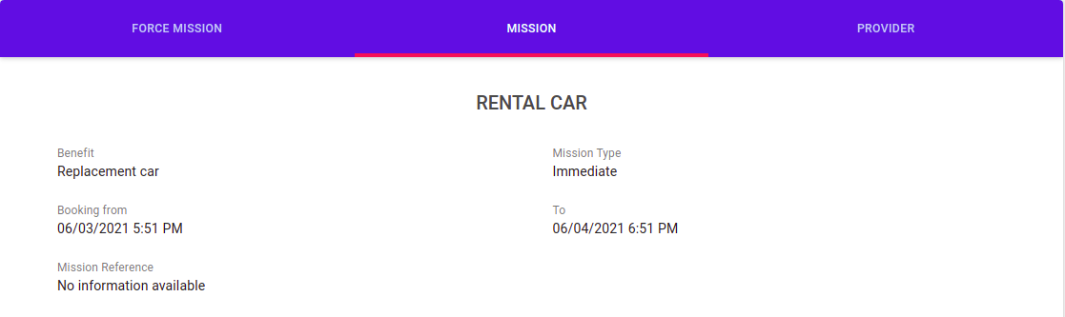
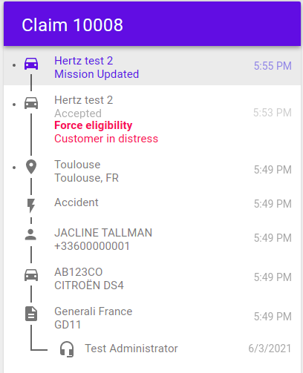
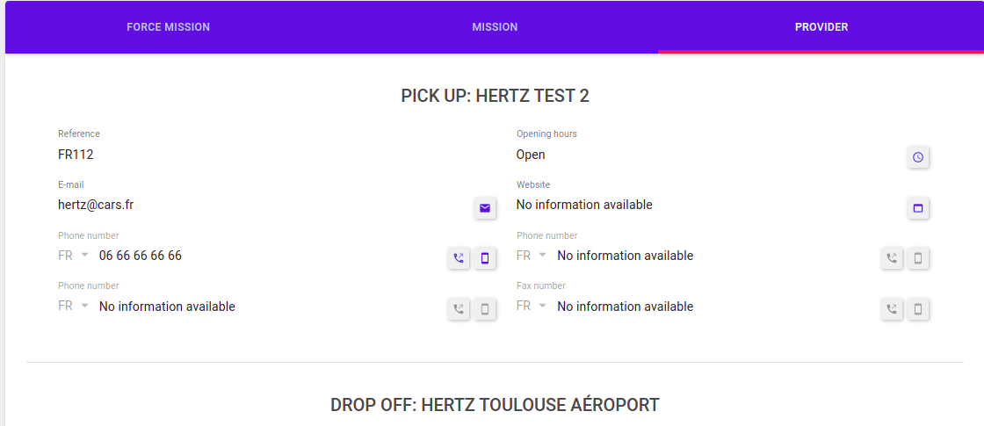
Claim overview impacts (without force eligibility)
Impact: Low / Digital: No
Reference
COREDRSA-6147
Context
As an operator consulting a claim overview I will be able to see all the information about an advanced rental mission.
RENTAL CAR
EOM

Slide 10
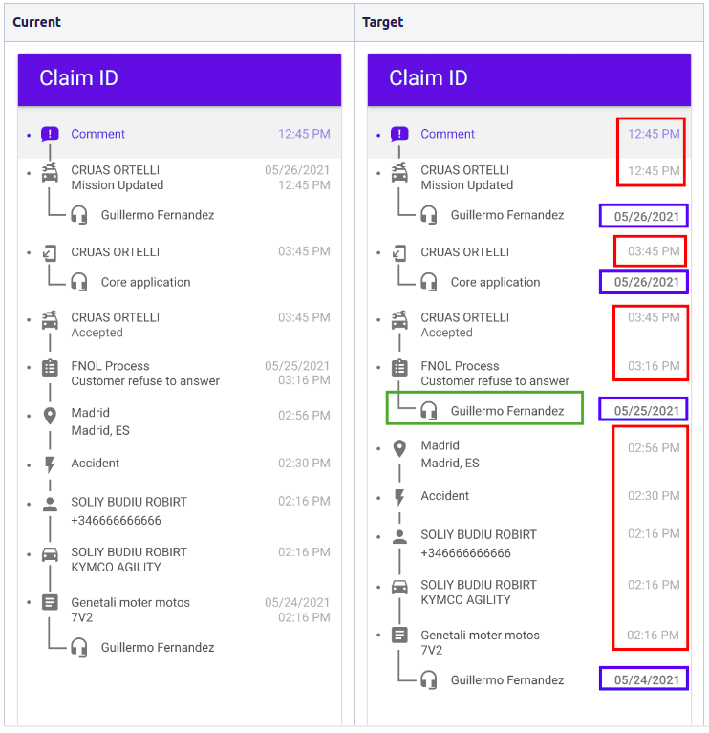
Review display of date, time and user in timeline
Impact: Low / Digital: No
Reference
COREDRSA-7019
Context
As an operator consulting a claim overview,
I want to clearly identify who does what and when
In order to know all about an existing claim.
RENTAL CAR
EOM

Slide 11
Adapt BRE with new RENTAL advanced mission
Impact: Medium / Digital: No
Reference
COREDRSA-5961
Context
BRE can now handle Rental advanced missions
RENTAL CAR
GYA

Slide 12
Search claim by provider (rental)
Impact: High / Digital: No
Reference
COREDRSA-6238
Context
In Complex search:
Searching by provider name will only return advanced missions (Rental, Crane, Tow and ROS + highways)
Provider name search will no longer return legacy missions such as Taxi, Legacy Rental, etc.
RENTAL CAR
GYA
Notes:
Rental: Chercher “Hertz” Taxi: Chercher “Capitole” ou “Taxi” vers claim 10024
“Now I pass the mic to the RED team”

Slide 13
TOW - Custom vehicle destination justification

Slide 14
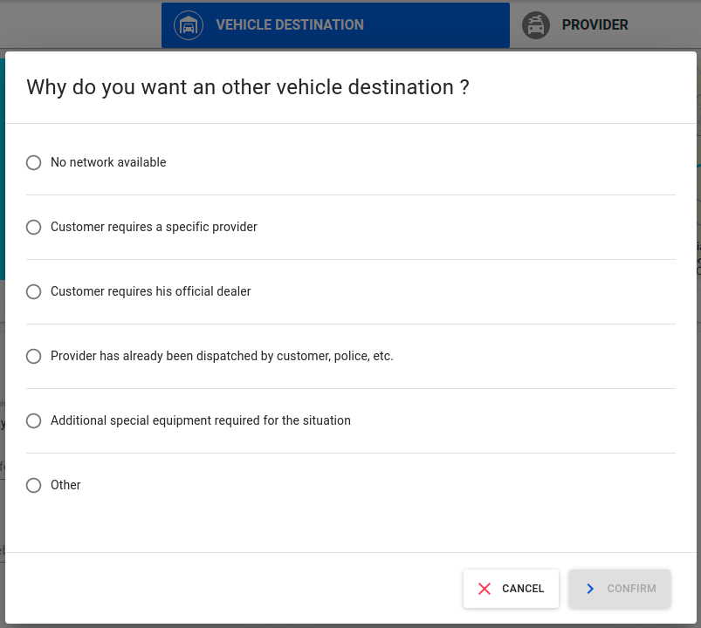
Justification of custom address for vehicle destination of a TOW mission
Impact: Medium / Digital: No
Reference
COREDRSA-4979
Context
In the current version, when an operator creates a custom address for the vehicle destination, they can’t provide the justification of why the choice of using a custom address has been made.
Thus, we implemented a new modal with reasons for the operator to select the accurate justification.
Vehicle destination => Custom address reason
NEV

Slide 15
PROVIDER REPORTS

Slide 16
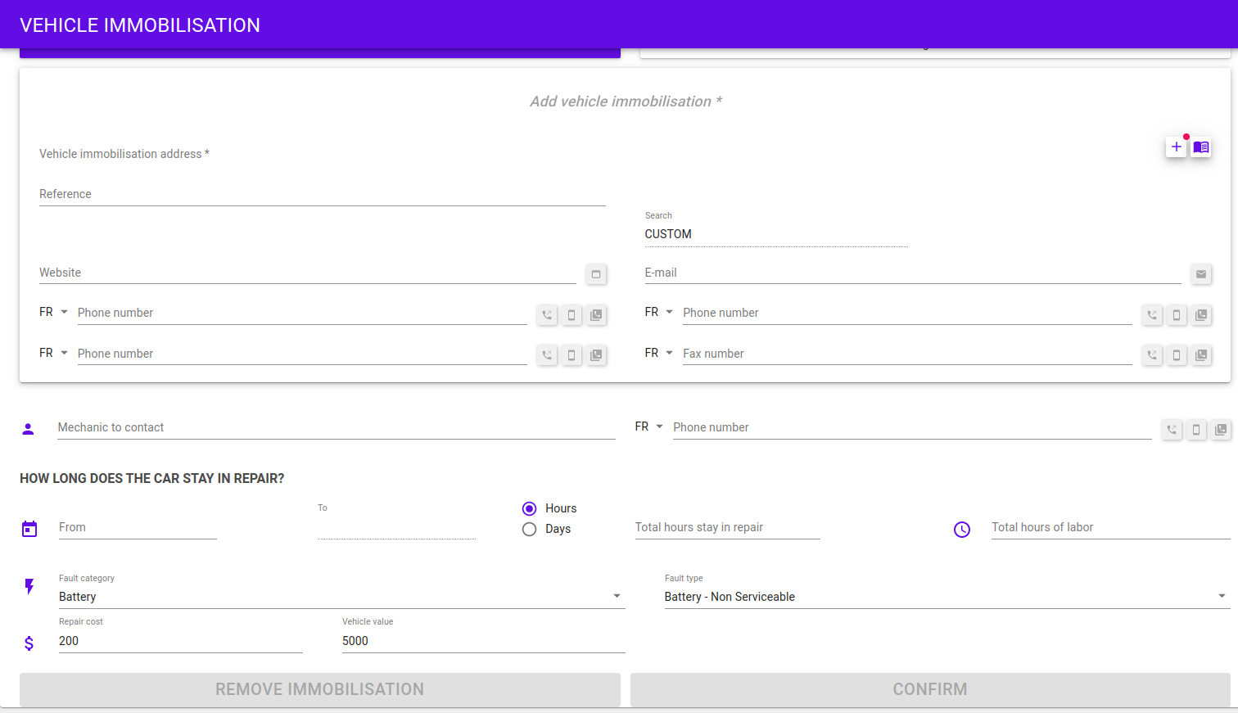
Add fault and vehicle values in immobilization screen
Impact: Medium / Digital: No
Reference
COREDRSA-4801
Context
We added fault category, fault type, vehicle value and repair cost to vehicle immobilisation.
Vehicle immobilisation
ADA

Slide 17
Report’s rule in product configuration
Impact: High / Digital: No
Reference
COREDRSA-4805
Context
As an administrator
I need to configure the report rule in product
In order to comply with the business partner agreement and share this information with the provider
PROVIDER
REPORT
AGH

Slide 18
Implement provider feedback in Core Missioning API
Impact: High / Digital: No
Reference
COREDRSA-4798
Context
Implement Core Missioning API v3 with new provider report format
New endpoint : Clear intermediate stop
New endpoint : Alert for missing provider report
Modify endpoint : Update provider agent details with additional attributes (Fault category and Fault type)
Modify endpoint : Add or modify provider report (with new format)
PROVIDER
REPORT
AGH

Slide 19
Restraint access of report modification
Impact: Medium / Digital: No
Reference
COREDRSA-6681
Context
As an operational manager. I want to define who has the right to modify a provider report. In order to restraint modification and keep tracability. So we should create a new operator role MODIFY_REPORT and assign it to a new MANAGER permission.
API Doc
PROVIDER
REPORT
AGH

Slide 20
CRASH EVENT

Slide 21
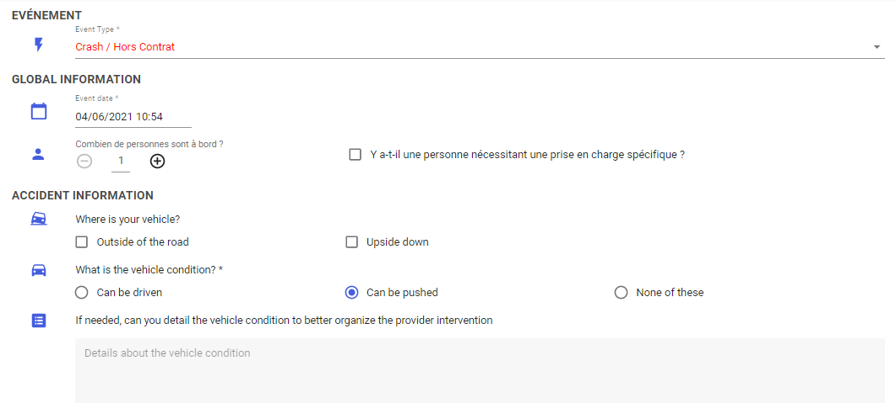
Creation of a new CRASH event
Impact: Low / Digital: No
Reference
COREDRSA-5650
Context
The operator will be able to create a new CRASH event
CRASH EVENT
AGH

Slide 22
API & TRANSLATION
UPDATES

Slide 23
New API implementation
API | Topic | Reference | Impact | Digital
Public API v1 | Create digital interaction | COREDRSA-6188 | Medium | yes
Core Missioning v3 | Provider Report | COREDRSA-4798 | High | No
Affiliate Missionning v3 | Provider Report - product config New crash event | COREDRSA-4805 COREDRSA-5650 | Medium | No
Quotation v3.1 & v2.4 | New CRASH event | COREDRSA-5650 | Medium | No
Affiliate CTI : v2.1 & v1.3 | New CRASH event | COREDRSA-5650 | Medium | No
Public API: v1.7 & v0.46 | New CRASH event | COREDRSA-5650 | Medium | yes
NEW API
JPI

Slide 24
Some wordings have been added / updated:
Screen | Translation key | English translation
Report | ReportModal.labelUpdate | Update report
Report | ReportModal.labelAdd | Add report
Report | ReportModal.reportReference | Report reference
Report | ReportModal.validate | Save
Report | ReportModal.information | Information (example: issue with the customer, etc)
Report | ReportModal.addMoreDetails | Add more details
Report | Core.missioning.task.REQUEST_MISSION_REPORT | A mission report is requested
Report | Core.missioning.task.REVIEW_MISSION_REPORT | The mission report must be reviewed
Report | TaskType.Goal.RSA.CONTACT_PROVIDER.REVIEW_MISSION_REPORT | Review a mission report
CORE
TRANSLATIONS
JPI

Slide 25
Some wordings have been added / updated:
Screen | Translation key | English translation
Report | Report.CANCELLED | Cancelled
Vehicle immobilisation | VehicleImmobilisation.repairCost | Repair cost
Vehicle immobilisation | VehicleImmobilisation.vehicleValue | Vehicle value
Tow - Custom vehicle destination | vehicleDestination.SelectionReasonModal.title | Why do you want an other vehicle destination ?
CORE
TRANSLATIONS
JPI

Slide 26
ROADMAP
&
NEXT PRIORITIES

Slide 27
Feature | Done | Work in progress or To Do
Public API for advanced missioning 75% | Search vehicle destinations Get tow limits Get all missions of the claim Update mission type Drop mission Digital interactions | Select vehicle destination Create and dispatch a mission
Provider report management 100 % | Display the list of provider’s report Add an edit report Add fault category and type in mission provider details Design and implement new product configuration Design and implement provider’s feedback in core missioning API Restraint access to report modification
TOW - Vehicle destination justification 100% | Implement custom justification for vehicle destination
New crash alert event 100% | Add new event “CRASH”
Modify claim |  | Design new routes to modify subs + vehicle + driver Modify subscription Modify driver Modify vehicle ...
RED
STORY MAP
YFA

Slide 28
Feature | Done | Work in progress or To Do
Advanced missioning - Rental car | Front skeleton Domain model and data base Quotation and missioning | Mission panels and mission info (31/32) Mission management (10/17 + 3 in progress) Legacy replacement (0/1)
BLUE
STORY MAP
MXB

Slide 29
Feature/ Epic | Done | In progress/ ToDo
Reporting digital exits 85% Complete | Designing digital exits reason implementation Digital exit endpoint for Claims Digital exit endpoint for missions Digital exit endpoint for DI Exit reasons for BRE Exit reasons for Core Add BRE event Data export: Desing digital exit reason payload Core digital exits + task creation Data Export implement digital exit reason payloadN Display Claim and mission exit reasons in timeline Allow a mission to receive a digital exit after PENDING status | Display DI exit in DI page
Benefit recommendation 83% Complete | Display new Benefit recommendation condition Display new service recommendation condition Display service recommendation conditions in Force eligibility modal Display new Benefit recommendation limits in claim timeline | Display benefit conditions in force eligibility modal for update & send mission
Product Migration 60% complete | Benefit recommendation mecanism based on covered area Product digital solution filter | RSA (inc Highway) provider network and radius selection Rental network prioritization Product code & name Product digital solution filter Other provider and radius selection
YELLOW
STORY MAP
SME

Slide 30
Feature/ Epic | Done | In progress/ ToDo
GDPR- Cookies Management 70% Complete On Hold | Implement Analytics consent Analytics activation related to cookies consent Cookies banner should be reachable on all WebApp workflow steps | Cookies conscent stockage
Public API V1 50% Complete | Consume new public API v1 Digital exits Implement public API v1 Claim endpoint Implement public API select location Implement public API select event | Implement public API v1 Mission endpoint Public API v1 car destination management Refresh management impact
Technical improvements | Unused settings clean-up Extract all Analytics tags & events Responsive Design improvements | Unused Anatytics clean-up
NPS Page |  | New NPS page requested by EADE
AF
STORY MAP
SMH

Slide 31

22/06
Shift demo - EA Portugal
23/06
Delivery Board - DRSA update
24/06
Training - Digital e-learning with 360
AGENDA
DRSA Change Advisory Board
25/06
Design workshop - Reviewing solution proposed
30/06
Release in PRD CORE v1.60.x & Webapp v3.21.x
02/07
DEMO
ASO

